Slide 1

International
Projects

Slide 2
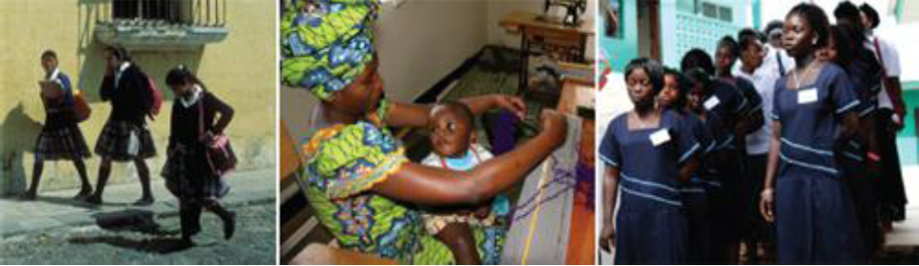
ZONTA
INTERNATIONAL SERVICE PROGRAM (ISP)

Slide 3
Helping women in developing countries has been a passion of Zontians since 1919.
Zonta's
International Service Program (ISP)
help women in developing countries improve:
  their legal,
  political,
  economic,
  educational
  and health status.

Slide 4
The Zonta International Foundation
The Program has provided:
➢ training, ➢ education,
➢ health, ➢ sanitation,
➢ agricultural and
➢ micro-credit assistance to women
Primarily through projects implemented by the agencies of the United Nations and other recognized non-governmental organizations.

Slide 5
Zonta International Service Programs
Fund 2012 -2014
Two specific projects
$2,000,000 US

Slide 6
Elimination of Mother to Child Transmission (MTCT) of HIV and Respond to Survivors of Domestic and Gender-Based Violence in Rwanda
Project One
Zonta International Service Project Designated Funding:
US $1,000,000

Slide 7
Goal #1: Elimination of Mother – to - Child Transmission (MTCT) of HIV
Rwanda is one of the poorest countries in the world
5.4 Million are children
  220,000 of whom are orphans due to AIDs
  100,00 of whom of whom live in child-headed households
Building on the success of the 2010 - 2012 Biennium project, the project will now move from prevention to the elimination of mother-to-child transmission of HIV by 2015.

Slide 8
Goal #2: Reduce incidence and lessen impact of Gender-Based Violence
Support government in:
Expanding one stop centres for the prevention of and response to domestic and gender-based violence in all 5 provinces.
Establish guidelines for multidisciplinary care for survivors and treated to quality care.
Support data collection to establish evidence for domestic and gender-based violence and connection to transmission of HIV
Support national & community-level mobilization campaigns

Slide 9
Elimination of Obstetric Fistula and the Reduction of Maternal and Newborn Mortality and Morbidity in Liberia (supported since 2008)
Project Two
International Service Project Dedicated Funding:
US $1,000,000

Slide 10
Project will move from project-based treatment to treatment integrated into Government’s national health system
GOAL: Eliminate obstetric fistula in Liberia
with 4 Objectives:
Prevent: Fistula from occurring in the first place
Treat: Provide quality treatment for women and girls living with fistula
Rehabilitate: Rehabilitate and reintegrate fistula survivors
Support: Provide support to women with inoperable cases.

Slide 11
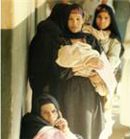
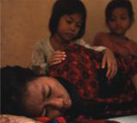
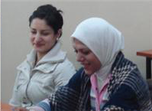
Zonta
International
Strategies to end
Violence
Against
Women
(ZISVAW)

Slide 12
ZISVAW GRANTS
Globally, gender-based violence is the most pervasive and least recognized human rights violation. Rooted in inequality, it affects women of every race, class, culture, ethnicity, age and country.
Zonta International strives to promote and protect the human rights of all women and girls and reduce the incidence of violence through the Zonta International

Slide 13
ZISVAW GRANTS
Strategies to End Violence Against Women Program by:
Supporting prevention and advocacy strategies locally and internationally.
Awarding grants to United Nations agencies or recognized NGOs for projects that seek to change personal and/or political knowledge, attitudes and behaviour contributing to gender-based violence.
Increasing awareness and actions related to preventing violence against women by encouraging Zonta club involvement in local and national advocacy initiatives and service projects.

Slide 14
Zonta
International
Strategies to end
Violence
Against
Women
ZISVAW GRANTS
2012 - 21014

Slide 15
Safe Cities for Women in Honduras
Funding: US $250,000
To the United Nations Entity for Gender Equality

Slide 16
Safe Cities for Women Project in Honduras
The same project was focused on Guatemala and El Salvador (2008 –2012) where it had significant results.
In Honduras, violence against women has increased more than 20% between 2010 and 2011.
Increase in crimes committed through hired killers.
At least 30 murders of women are directly related to hired killers.
Project will focus on 2 neighbourhoods of Tegucigalpa and Nueva Suyapa.

Slide 17
Empowering Women in Rural Samoa to Combat Violence
Funding: US $109,876
To the United Nations Trust Fund

Slide 18
Empowering Women in Rural Samoa to Combat Violence
Violence against women in Samoa (predominately 18 -65 yr old) is usually perpetrated by an intimate partner.
The World Health Organization found women in Samoa experienced:
41 % physical abuse
20% sexual abuse
More than 50% did not tell anyone.
Of the women that did not seek help
86% stated, they thought abuse was “normal” and “not serious.”

Slide 19
Mass Communication with a Purpose:
Global Partnership on Edutainment for Social Change
Funding: US $802,124
to the UN Trust Fund

Slide 20
Mass Communication with a Purpose:
Global Partnership on Edutainment for Social Change
Edutainment?
Is the term used to describe a proven approach that combines mass communication with community outreach to effect change.
Zonta’s goal is to transform the myth that violence against women (VAW) is “normal” and “inevitable”.
By integrating traditional and contemporary media

Slide 21
Goal: use mass media to challenge existing cultural norms and attitudes that condone and endorse VAW
Targeted Countries:
Nigeria and Bangladesh will be the focus in the 1st year.
10 Countries will follow on a smaller scale in the second year.
Countries with:
patriarchal cultures,
high population densities,
histories of violent conflicts
And countries where
women’s movements are restricted and
women lack access to support services.

